Slide 1

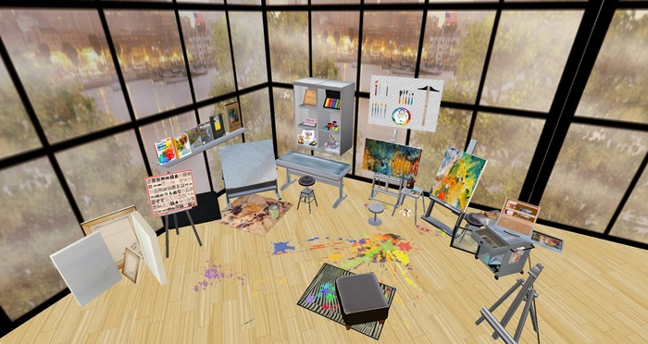
Benefits of Taking Art:
Increases motivation to learn
Allows for expression &
creativity
Heightens self-esteem
Develops cultural & historical awareness
Develops problem solving skills
Develops ability to make aesthetic judgement
Provides
fulfillment
Improves overall academic
performance
Develops self-discipline
Visual Arts & Media Design

Slide 2


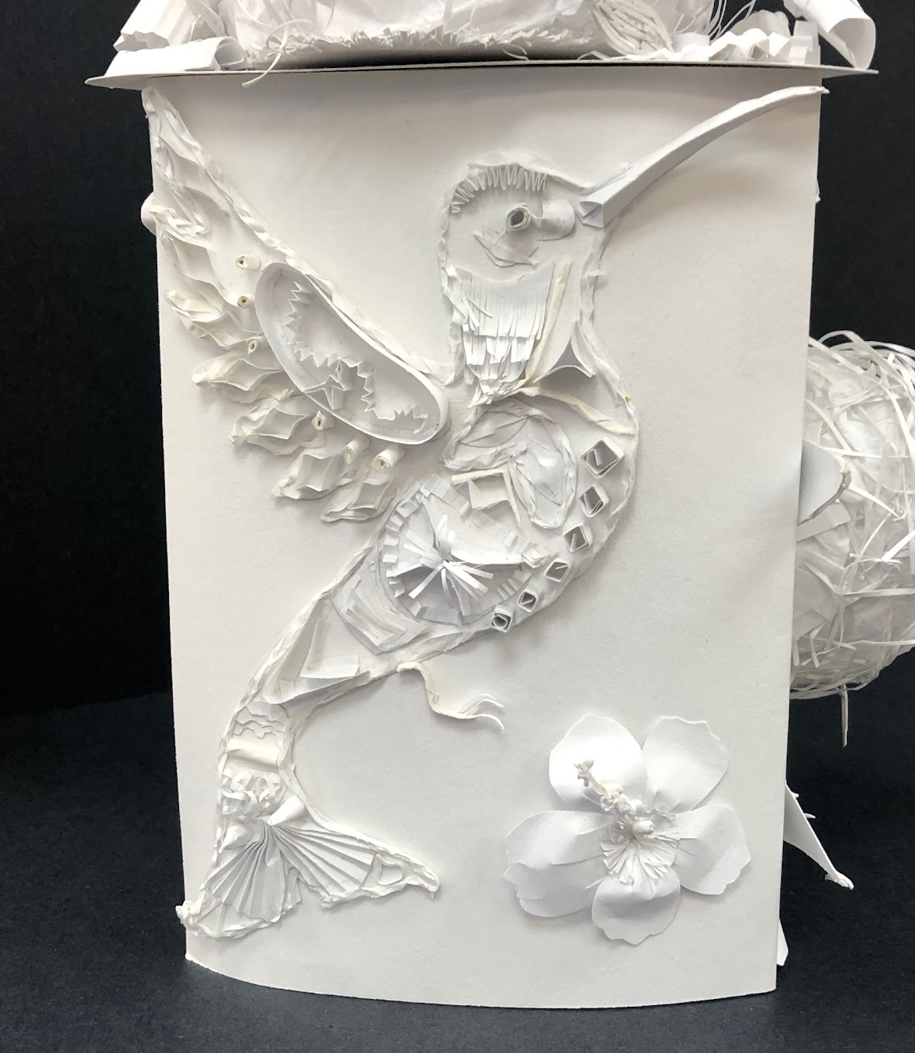
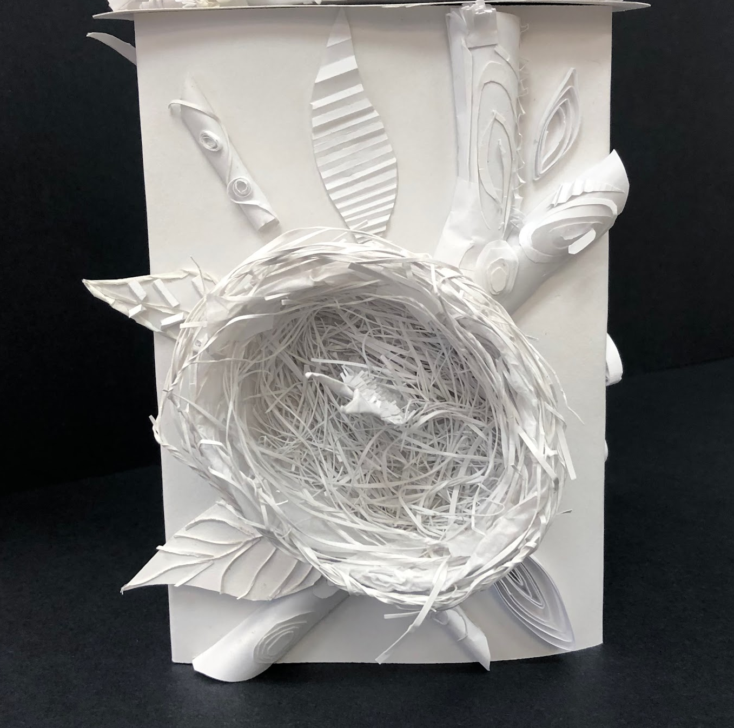
“Art is about inventing...not about copying” (Pablo Picasso)
Grade 9 ART at LSS: NAC1O1
The Grade 9 Art program is an introductory course that educates explores a variety of disciplines including drawing, painting, sculpture, photography, and digital media. Students learn the fundamentals of theory and techniques which they apply to this hands-on course in their studio work. Our talented teacher-artists appreciate the various skills students may or may not have upon entering this open level course, and teach with the individual in mind. Studio applications are demonstrated and taught with proper tools and lots of practice, and further enhanced through art history. The content focuses on learning and appreciating artists from a variety of Indigenous cultures across Canada through “storytelling” in all its forms.
Grade 9 Art - Paper Sculpture

Slide 3
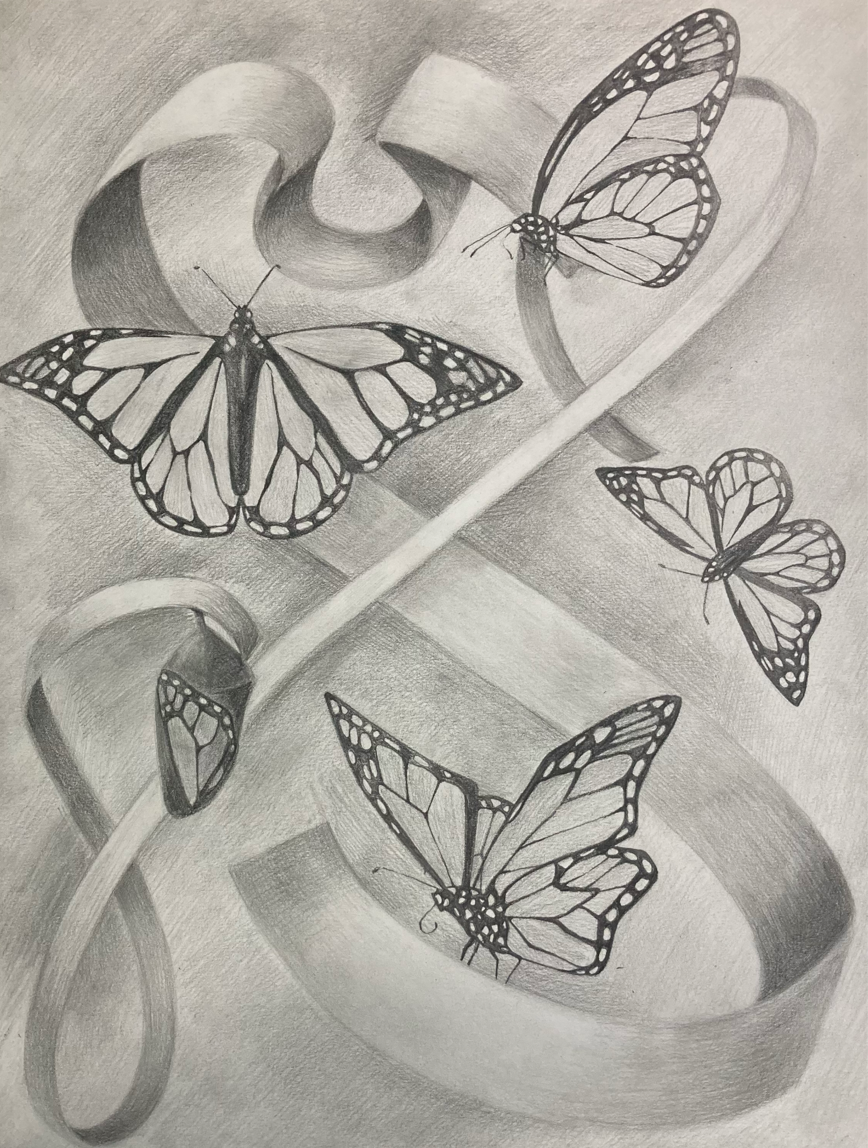
Why should I take Grade 9 Art?
Art is fun and helps to develop critical thinking skills.
Our program focuses on exploring and developing skills and techniques in a variety of disciplines.
All of our courses take a “cross-curricular” approach with connections made to history, math, science, and literature.
A growing body of research indicates that art programs actually improve students’ performance in academic subjects. (Alison Armstrong)
Our program offers options to study traditional art, media design and photography in Grades 10 through 12.
Grade 9 Art Drawing - Ribbons of Life

Slide 4
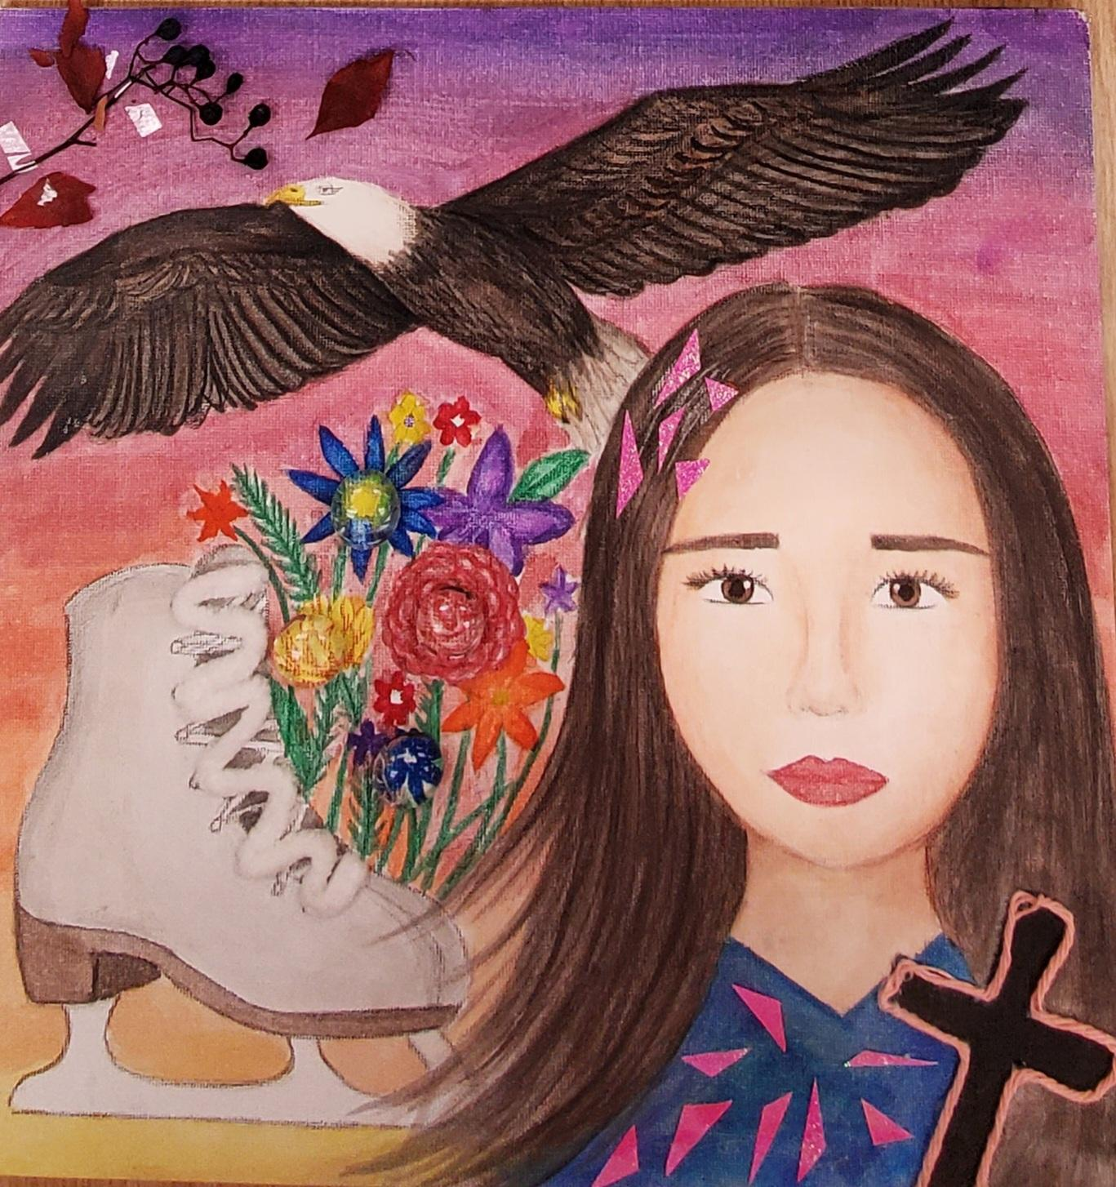
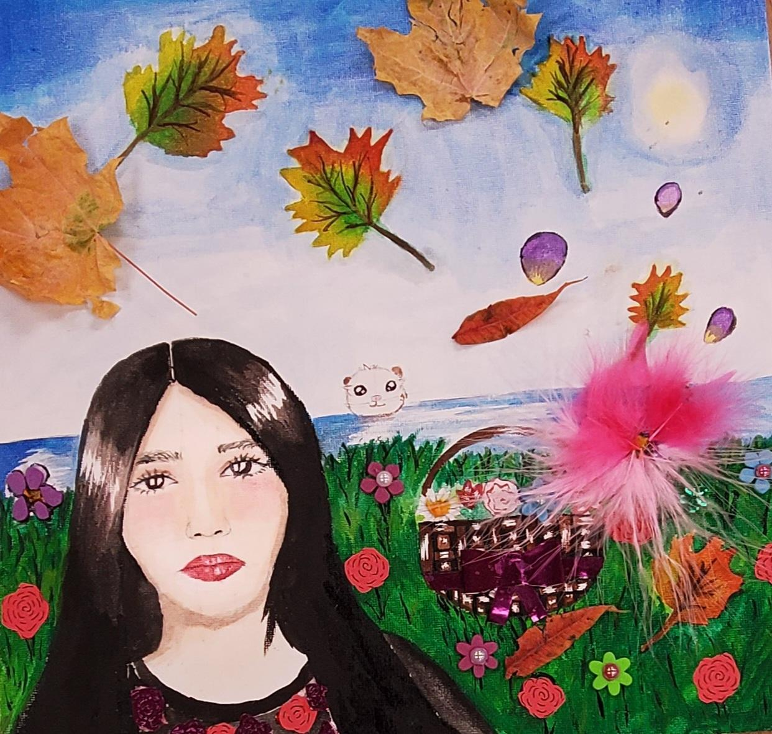
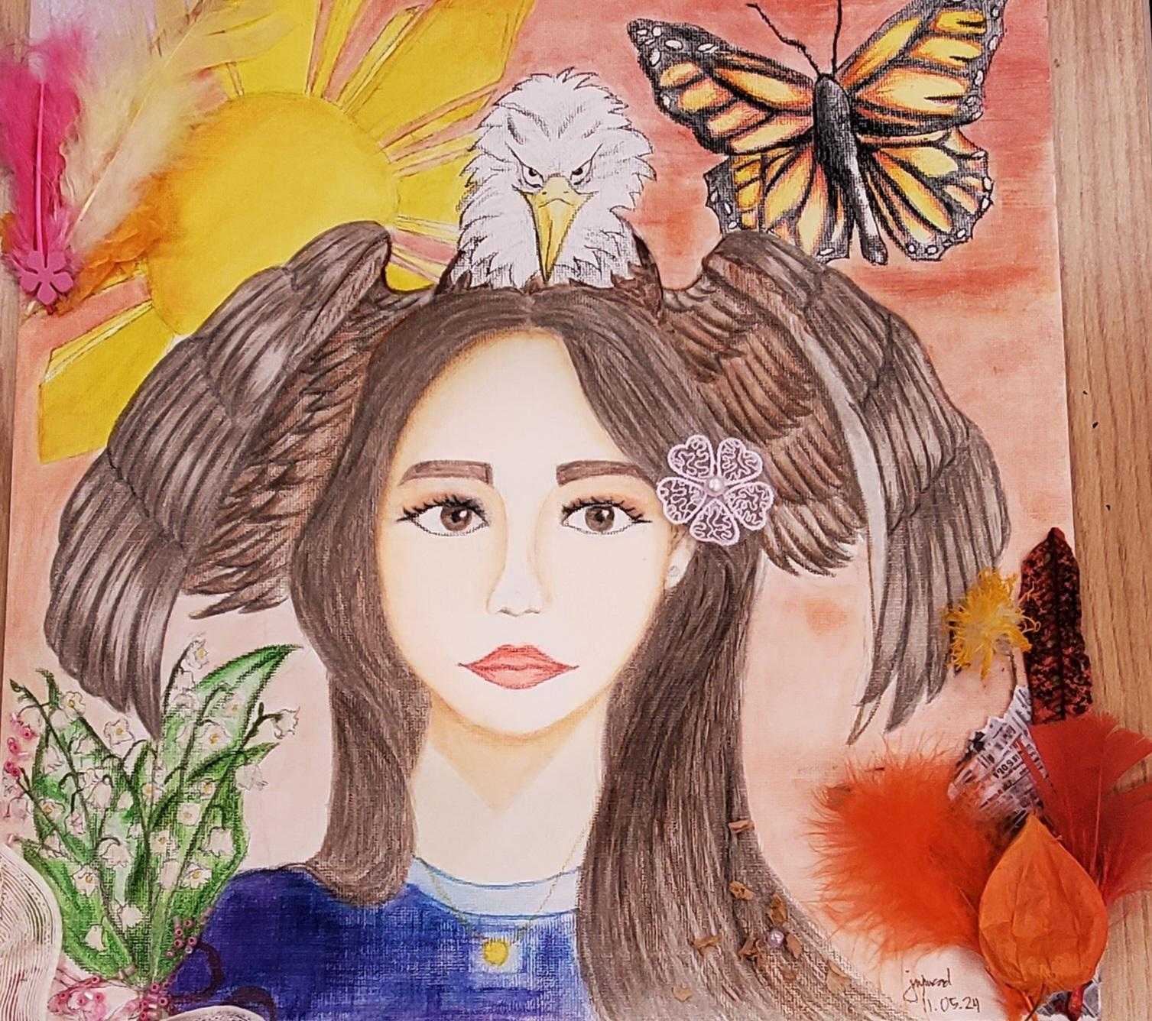
Links to Department Information:
Visual Arts Department at Langstaff S. S.
Visual Arts Dept. Certificate Program
25 FUN facts about the ARTS

Slide 5

Watch our video that showcases some of our student artworks.

